Slide 1
CSE225: Data Structure and Algorithms Types of Algorithms

Slide 2
Algorithm
An Algorithm is any well-defined computational procedure that takes some values or set of values as input and produces some values or set of values as output.
An Algorithm is a well defined list of steps to solve a particular problem.

Slide 3
NOTION OF ALGORITHM
problem
algorithm
“computer”
input
output
Algorithmic solution

Slide 4
SOME WELL-KNOWN COMPUTATIONAL PROBLEMS
Sorting
Searching
Shortest paths in a graph
Minimum spanning tree
Primality testing
Traveling salesman problem
Knapsack problem
Chess
Towers of Hanoi

Slide 5
Algorithms
Properties of a good Algorithm:
• Input from a specified set,
• Output from a specified set (solution),
• Effectiveness of each calculation step and
• Finiteness of the number of calculation steps,
• Correctness of output for every possible input

Slide 6
Types of Algorithms

Slide 7
Algorithm classification
Algorithms that use a similar problem-solving approach can be grouped together
This classification scheme is neither exhaustive nor disjoint
The purpose is not to be able to classify an algorithm as one type or another, but to highlight the various ways in which a problem can be attacked

Slide 8
A short list of categories
Algorithm types we will consider include:
Simple recursive algorithms
Divide and conquer algorithms
Dynamic programming algorithms
Greedy algorithms
Brute force algorithms

Slide 9
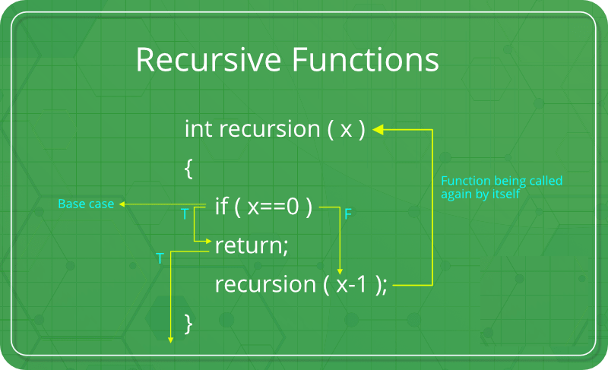
What is Recursion?
The process in which a function calls itself directly or indirectly is called recursion and the corresponding function is called as recursive function. Using recursive algorithm, certain problems can be solved quite easily. Examples of such problems are Towers of Hanoi (TOH), Inorder/Preorder/ Postorder Tree Traversals, DFS of Graph, etc.

Slide 10
Simple recursive algorithms I
A simple recursive algorithm:
Solves the base cases directly
Recurs with a simpler subproblem
Does some extra work to convert the solution to the simpler subproblem into a solution to the given problem
“simple” because several of the other algorithm types are inherently recursive

Slide 11
Finding the factorial of 3
fact(1)
1
fact(2)
fact(2)
fact(2)
2
fact(3)
fact(3)
fact(3)
fact(3)
fact(3)
6
main()
main()
main()
main()
main()
main()
Time 2:
Push: fact(3)
Time 3:
Push: fact(2)
Time 4:
Push: fact(1)
Time 5:
Pop: fact(1)
returns 1.
Time 6:
Pop: fact(2)
returns 2.
Time 7:
Pop: fact(3)
returns 6.
Inside findFactorial(3):
if (number <= 1) return 1;
else return (3 * factorial (2));
Inside findFactorial(2):
if (number <= 1) return 1;
else return (2 * factorial (1));
Inside findFactorial(1):
if (number <= 1) return 1;
else return (1 * factorial (0));

Slide 12
Divide and Conquer
A divide and conquer algorithm consists of two parts:
Divide the problem into smaller subproblems of the same type, and solve these subproblems recursively
Combine the solutions to the subproblems into a solution to the original problem
Traditionally, an algorithm is only called divide and conquer if it contains two or more recursive calls

Slide 13
Divide and conquer algorithm
Divide and conquer is an algorithm design paradigm.
A divide-and-conquer algorithm recursively breaks down a problem into two or more sub-problems of the same or related type, until these become simple enough to be solved directly.
The solutions to the sub-problems are then combined to give a solution to the original problem.
The divide-and-conquer technique is the basis of efficient algorithms for many problems, such as sorting (e.g., quicksort, merge sort), multiplying large numbers (e.g., the Karatsuba algorithm).

Slide 14
Examples
Quicksort:
Partition the array into two parts, and quicksort each
of the parts
No additional work is required to combine the two sorted parts
Mergesort:
Cut the array in half, and mergesort each half
Combine the two sorted arrays into a single sorted array by merging them

Slide 15
Dynamic programming algorithms
A dynamic programming algorithm remembers past results and uses them to find new results
Dynamic programming is generally used for optimization problems
Multiple solutions exist, need to find the “best” one
Requires “optimal substructure” and “overlapping subproblems”
Optimal substructure: Optimal solution contains optimal solutions to subproblems
Overlapping subproblems: Solutions to subproblems can be stored and reused in a bottom-up fashion
This differs from Divide and Conquer, where subproblems generally need not overlap

Slide 16
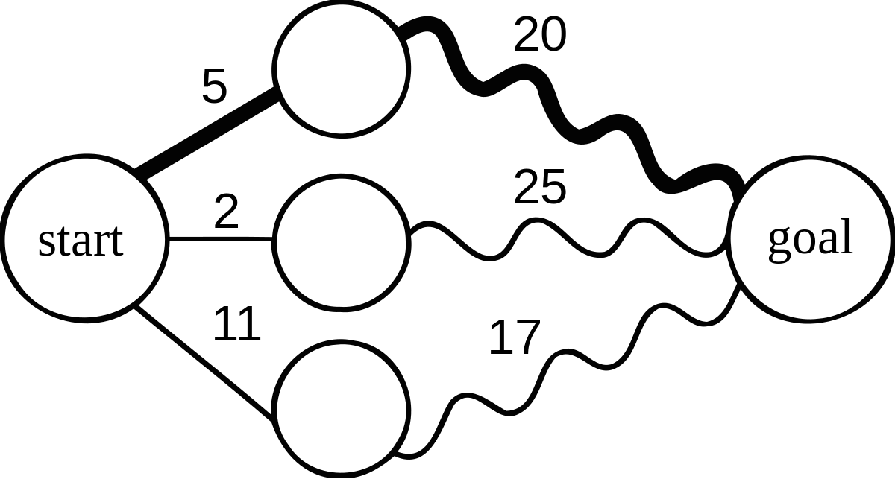
if a problem can be solved optimally by breaking it into sub-problems and then recursively finding the optimal solutions to the sub-problems, then it is said to have optimal substructure

Slide 17
Greedy algorithms
An optimization problem is one in which you want to find, not just a solution, but the best solution
A “greedy algorithm” sometimes works well for optimization problems
A greedy algorithm works in phases: At each phase:
You take the best you can get right now, without regard for future consequences
You hope that by choosing a local optimum at each
step, you will end up at a global optimum

Slide 18
Greedy algorithm
A greedy algorithm is any algorithm that follows the problem-solving heuristic of making the locally optimal choice at each stage.
In many problems, a greedy strategy does not usually produce an optimal solution, but nonetheless, a greedy heuristic may yield locally optimal solutions that approximate a globally optimal solution in a reasonable amount of time.
Example: Huffman Coding, TSP

Slide 19
Brute force algorithm
A brute force algorithm simply tries all
possibilities until a satisfactory solution is found
Such an algorithm can be:
Optimizing: Find the best solution. This may require finding all solutions, or if a value for the best solution is known, it may stop when any best solution is found
Example: Finding the best path for a travelling salesman
Satisficing: Stop as soon as a solution is found that is good enough
Example: Finding a travelling salesman path that is within 10% of optimal

